Slide 1



Deep Learning Using
Masoud Pourreza
Pourreza.masoud@gmail.com
https://www.aparat.com/partdpai

Slide 2

Torch
Open source machine learning library
Scientific computing framework
Based on the Lua !!
Research Companies and Labs
Facebook AI research, Google + Deep mind , Twitter, NVIDIA
Started at 2002
website

Slide 3
PyTorch
PyTorch is a python package that provides two high-level features:
Tensor computation (like numpy) with strong GPU acceleration
Deep Neural Networks built on a tape-based autograd system
PyTorch provides Tensors that can live either on the CPU or the GPU
PyTorch is a python library
More Pythonic (imperative)
Flexible
Intuitive and cleaner code
Easy to debug
More Neural Networkic
Write code as the network works
forward/backward

Slide 4
PyTorch packages
Package | Description
torch | a Tensor library like NumPy, with strong GPU support
torch.autograd | a tape based automatic differentiation library that supports all differentiable Tensor operations in torch
torch.nn | a neural networks library deeply integrated with autograd designed for maximum flexibility
torch.optim | an optimization package to be used with torch.nn with standard optimization methods such as SGD, RMSProp, LBFGS, Adam etc.
torch.multiprocessing | python multiprocessing, but with magical memory sharing of torch Tensors across processes. Useful for data loading and hogwild training.
torch.utils | DataLoader, Trainer and other utility functions for convenience
torchvision
The torchvision package consists of popular datasets, model architectures, and common image transformations for computer vision.

Slide 5
Installation requirements
Python on ubuntu
Python on windows
Pip on ubuntu
Pip on windows
conda on ubuntu
conda on windows

Slide 6
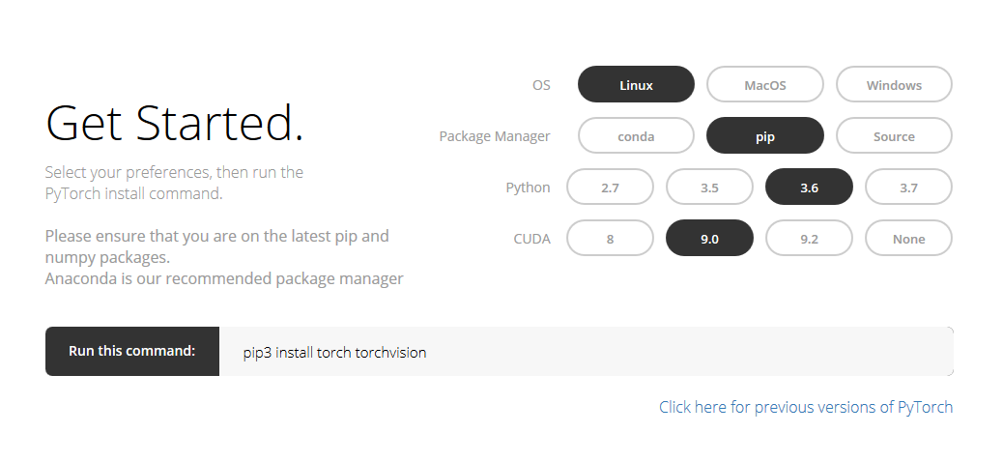
PyTorch Installation
http://pytorch.org

Slide 7
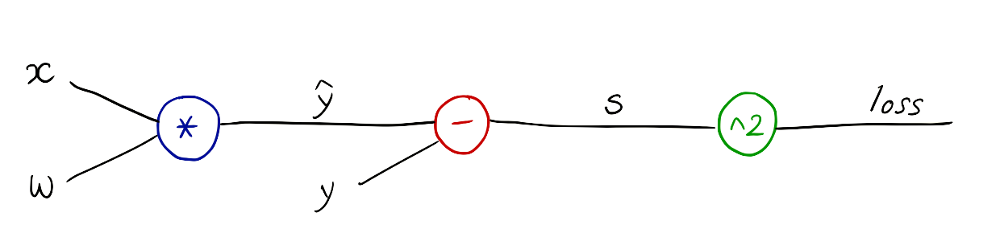
Computational Graph

Slide 8

PyTorch Basics

Slide 9
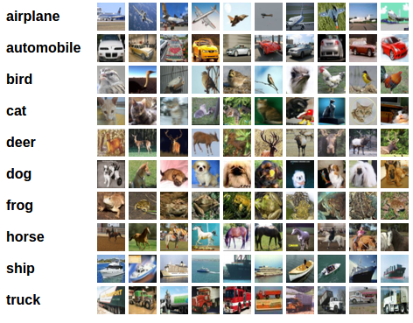
Classification Problem
Image Size = 3×32×32

Slide 10




PyTorch Rhythm
Design your model using class with Variables
Construct loss and optimizer (select from PyTorch API)
Training cycle (forward, backward, update)

Slide 11
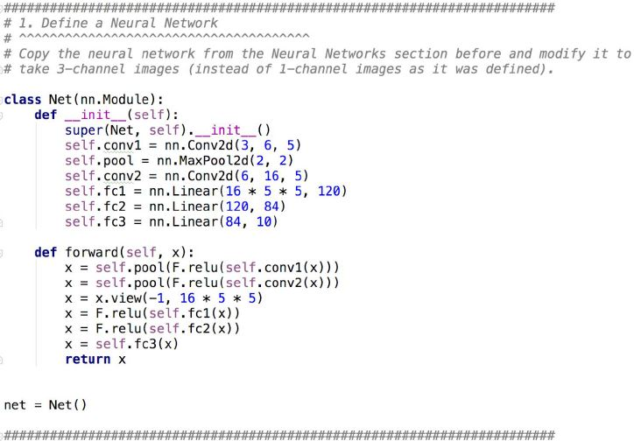
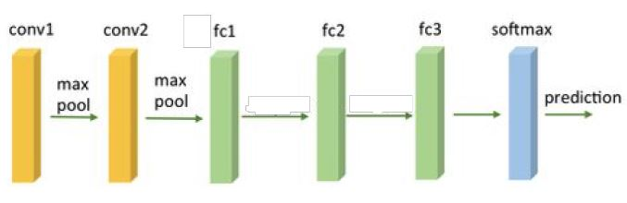
Classification Problem
Design your model using class with Variables

Slide 12
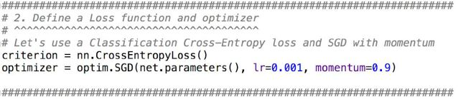
Cifar10 classification
Construct loss and optimizer (select from PyTorch API)

Slide 13
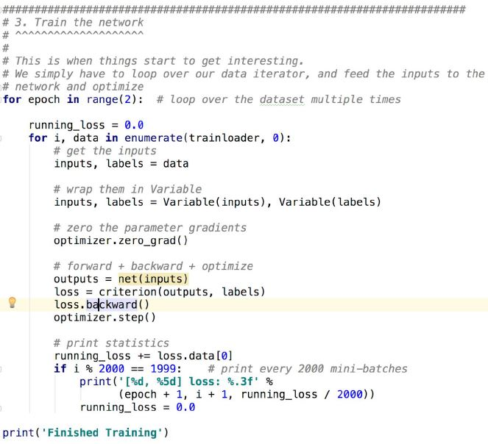
Cifar10 classification
Training cycle (forward, backward, update)

Slide 14
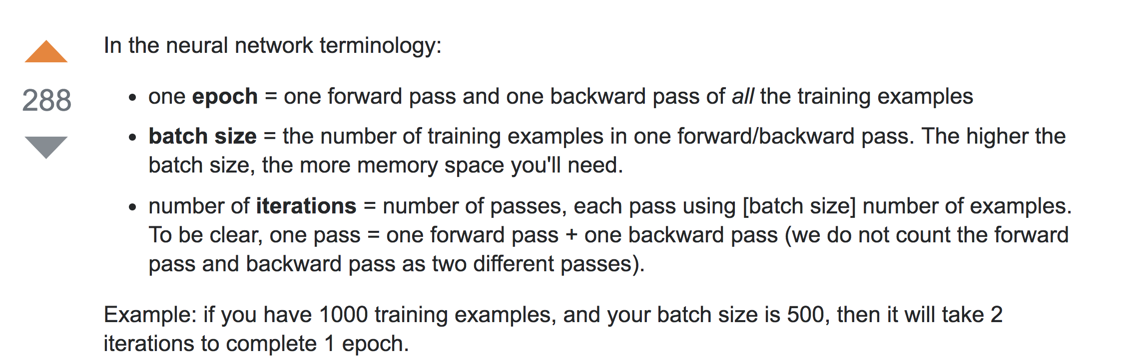
Batch (batch size)
# Training cycle
for epoch in range(training_epochs):
# Loop over all batches
for i in range(total_batch):
batch_xs, batch_ys = …

Slide 15
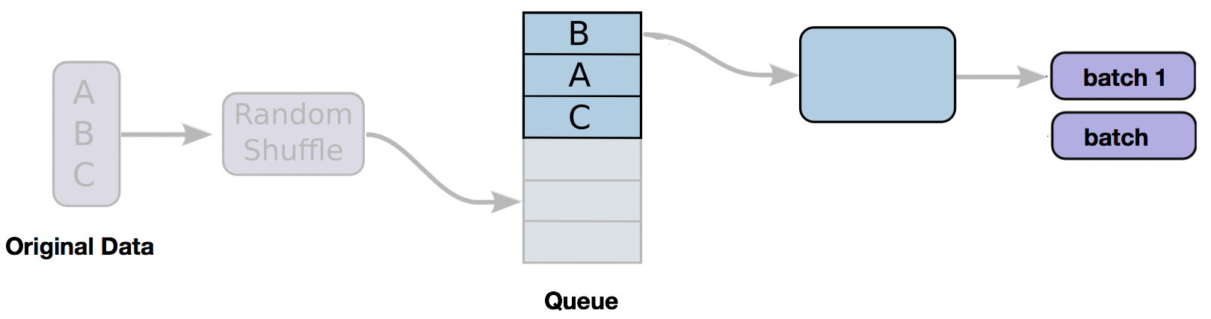
Data Loader

Slide 16
Transfer Learning / freeze layers
Transfer learning is a machine learning technique where a model trained on one task is re-purposed on a second related task.
Transfer learning is an optimization that allows rapid progress or improved performance when modeling the second task

Slide 17
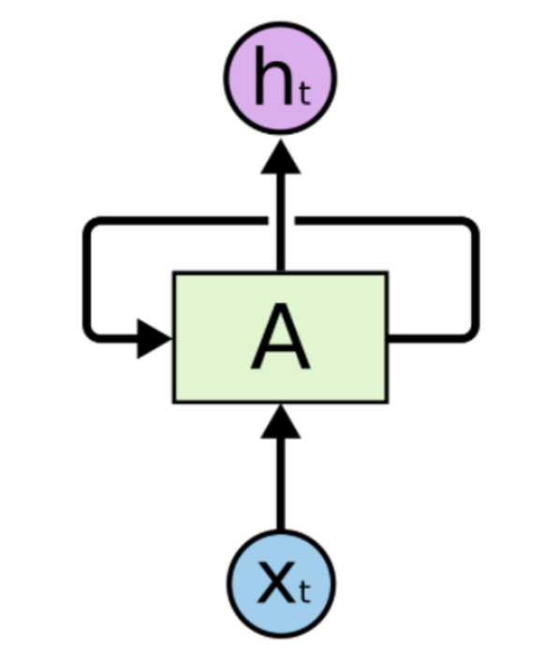
RNN in Pytorch

Slide 18
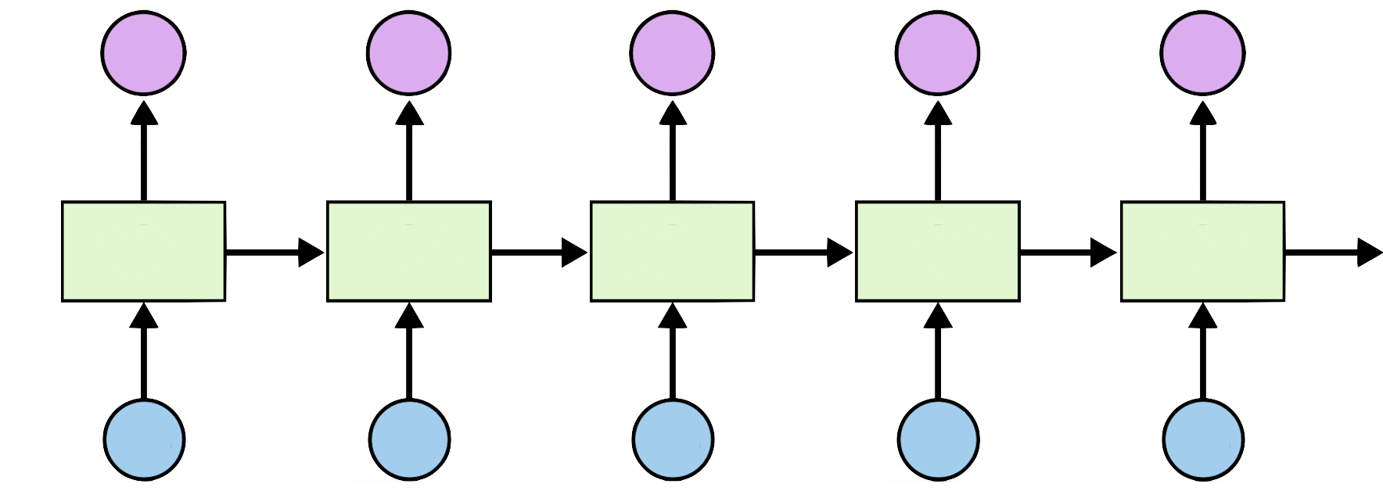

RNN
Y1
Y2
Y3
Y4
Y5
X1
X2
X3
X4
X5

Slide 19
RNN Applications: series of data
Time series prediction
Language modeling (text generation)
Text sentiment analysis
Named entity recognition
Translation
Speech recognition
Anomaly detection in time series
Music composition
...

Slide 20
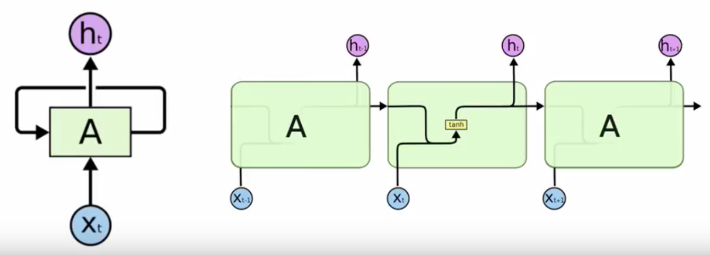
RNN inside

Slide 21
RNN in PyTorch
cell = nn.RNN(input_size=4, hidden_size=2, batch_first=True)
cell = nn.LSTM(input_size=4, hidden_size=2, batch_first=True)
cell = nn.GRU(input_size=4, hidden_size=2, batch_first=True)
inputs = ... # (batch_size, seq_len, input_size) with batch_first=True
hidden = (... , ...) # (num_layers, batch_size, hidden_size)
# Bidirectional RNN*
hidden = (... , ...) # (num_layers*2, batch_size, hidden_size)
...
out, hidden = cell(inputs, hidden)

Slide 22
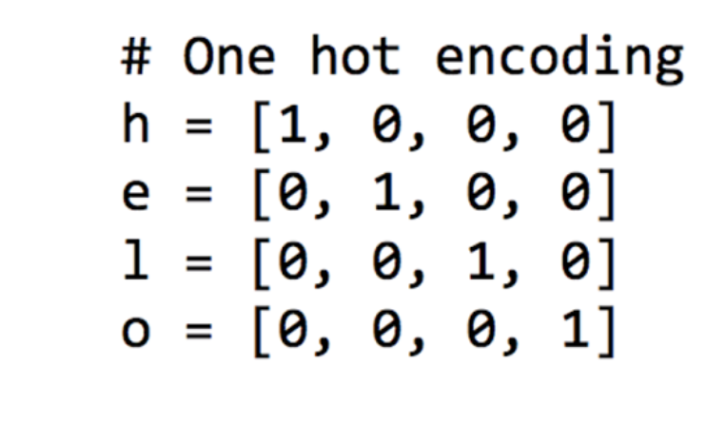
One hot encoding for letters, h, e, l, l, o

Slide 23
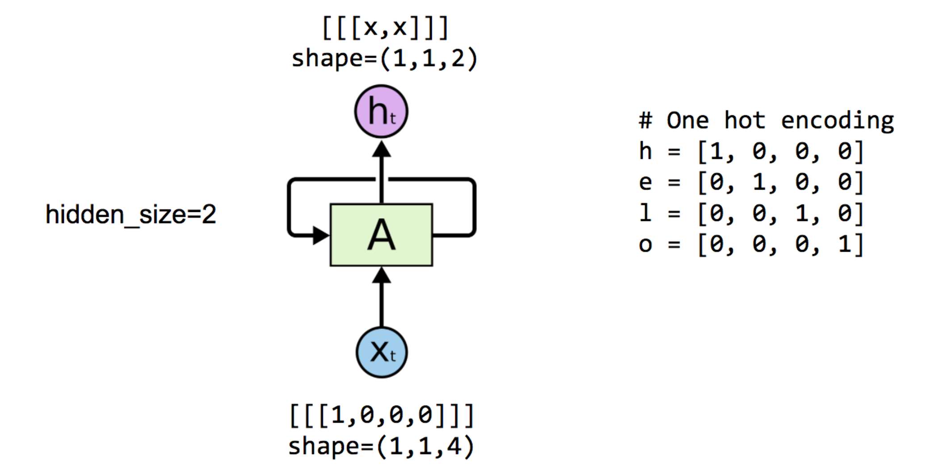
One node: 4 (input-dim) in 2 (hidden_size)

Slide 24
One node: 4 (input-dim) in 2 (hidden_size)

Slide 25
One node: 4 (input_dim) in 2 (hidden_size)
# One cell RNN input_dim (4) -> output_dim (2) cell = nn.LSTM(input_size=4, hidden_size=2, batch_first=True)
# One letter input
inputs = (torch.Tensor([[h]])) # rank = (1, 1, 4)
# initialize the hidden state.
# (num_layers * num_directions, batch, hidden_size)
hidden = ((torch.randn(1, 1, 2)))
# Feed to one element at a time.
# after each step, hidden contains the hidden state.
out, hidden = cell(inputs, hidden)
print("out", out.data)
-0.1243 0.0738
[torch.FloatTensor of size 1x1x2]

Slide 26
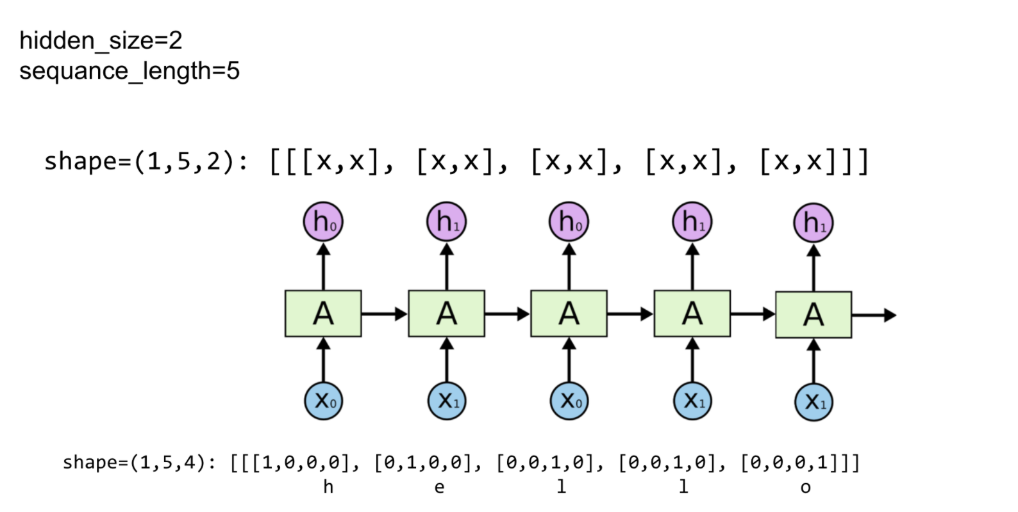
Unfolding to n sequences
hidden_size=2
seq_len=5

Slide 27
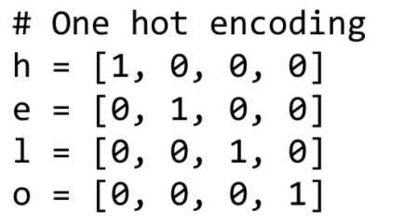
Unfolding to n sequences
# One cell RNN input_dim (4) -> output_dim (2). sequence: 5
cell = nn.LSTM(input_size=4, hidden_size=2, batch_first=True)
inputs = (torch.Tensor([[h, e, l, l, o]]))
print("input size", inputs.size())
hidden = ((torch.randn(1, 1, 2))) # clean out hidden state
out, hidden = cell(inputs, hidden)
print(out.data)
input size torch.Size([1, 5, 4]) (0 ,.,.) = -0.1825 0.0737 -0.1981 0.1164 -0.3367 0.2095 -0.3625 0.2503 -0.2038 0.3626 [torch.FloatTensor of size 1x5x2]
hidden_size=2
seq_len=5

Slide 28
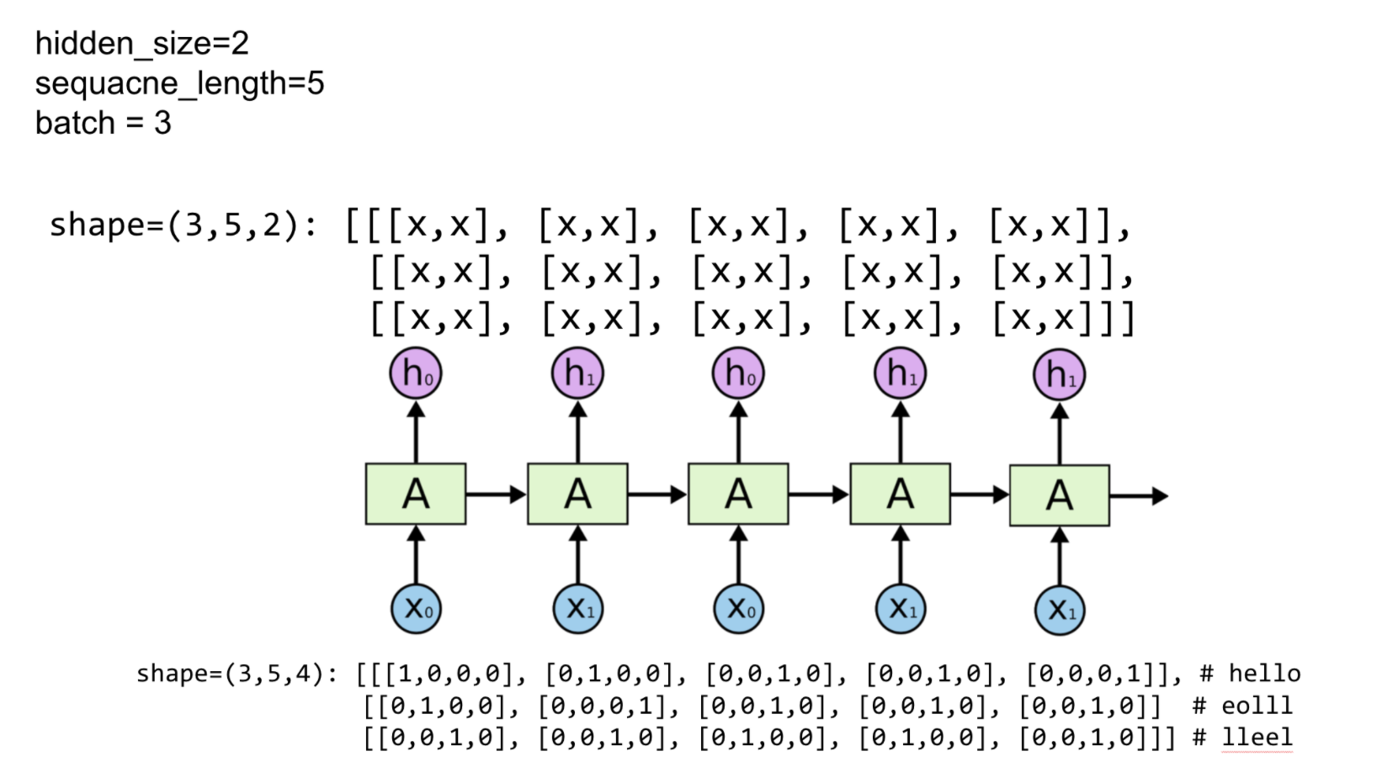
Batching input
Hidden_size=2
sequence_length=5
batch_size=3

Slide 29
Batching input
# One cell RNN input_dim (4) -> output_dim (2). sequence: 5, batch 3 # 3 batches 'hello', 'eolll', 'lleel' # rank = (3, 5, 4)
inputs = (torch.Tensor([[h, e, l, l, o],
[e, o, l, l, l],
[l, l, e, e, l]]))
print("input size", inputs.size()) # input size torch.Size([3, 5, 4])
# (num_layers * num_directions, batch, hidden_size)
hidden = ((torch.randn(1, 3, 2)),(
torch.randn((1, 3, 2))))
out, hidden = cell(inputs, hidden)
print("out size", out.size()) # out size torch.Size([3, 5, 2])
Hidden_size=2
sequence_length=5
batch_size=3

Slide 30
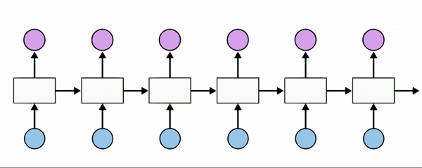
[1, 0, 0, 0, 0], # h 0
[0, 1, 0, 0, 0], # i 1
[0, 0, 1, 0, 0], # e 2
[0, 0, 0, 1, 0], # l 3
[0, 0, 0, 0, 1], # o 4
Teach RNN ‘hihell’ to ‘ihello’

Slide 31
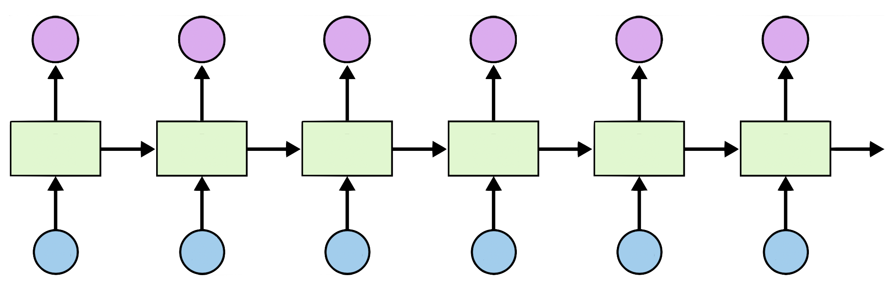
[1, 0, 0, 0, 0], # h 0
[0, 1, 0, 0, 0], # i 1
[0, 0, 1, 0, 0], # e 2
[0, 0, 0, 1, 0], # l 3
[0, 0, 0, 0, 1], # o 4
Teach RNN ‘hihell’ to ‘ihello’
output_dim = 5
[0, 1, 0, 0, 0]
[1, 0, 0, 0, 0]
[0, 1, 0, 0, 0]
[0, 1, 0, 0, 0]
[0, 1, 0, 0, 0]
[0, 0, 0, 0, 1]
i
h
e
l
l
o
h
i
h
e
l
l
[1, 0, 0, 0, 0]
[0, 1, 0, 0, 0]
[1, 0, 0, 0, 0]
[0, 1, 0, 0, 0]
[0, 1, 0, 0, 0]
[0, 1, 0, 0, 0]
Input_dim = 5

Slide 32
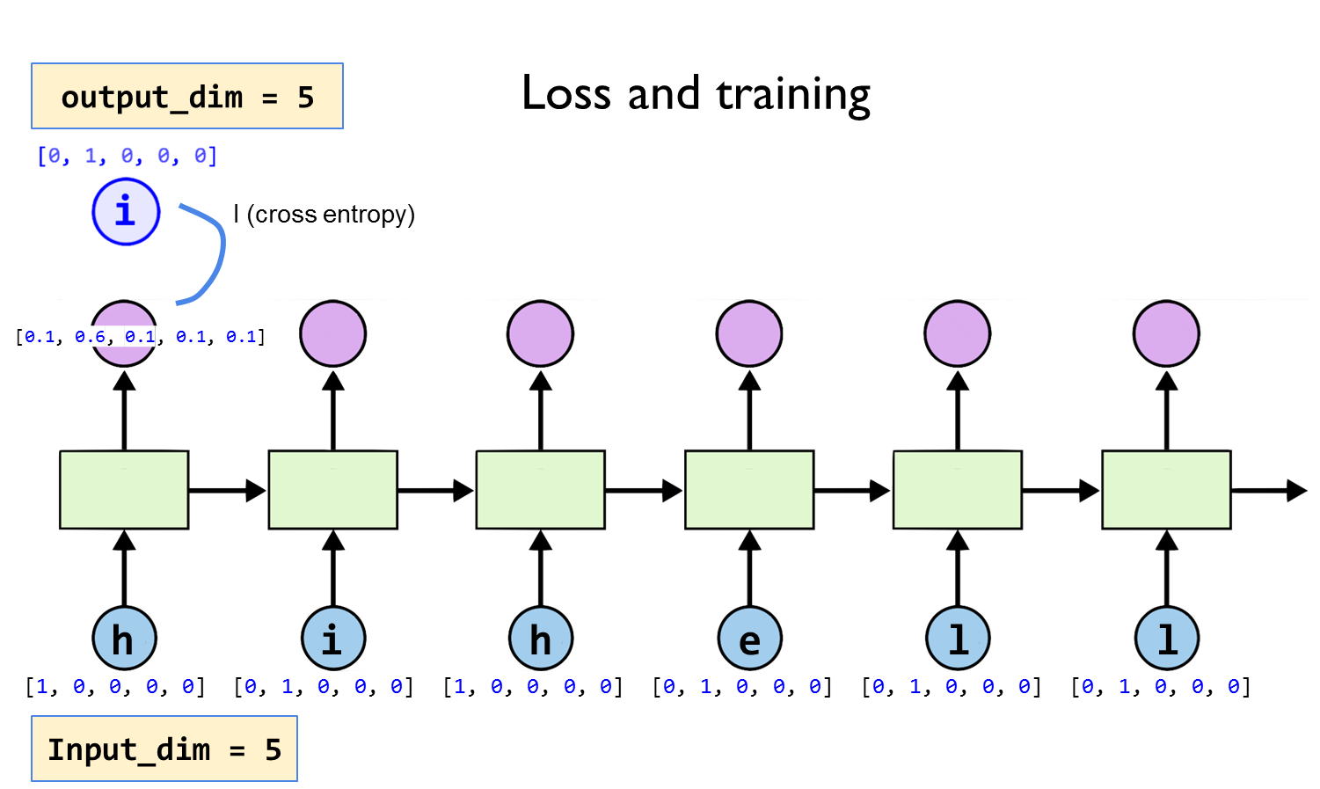

Slide 33
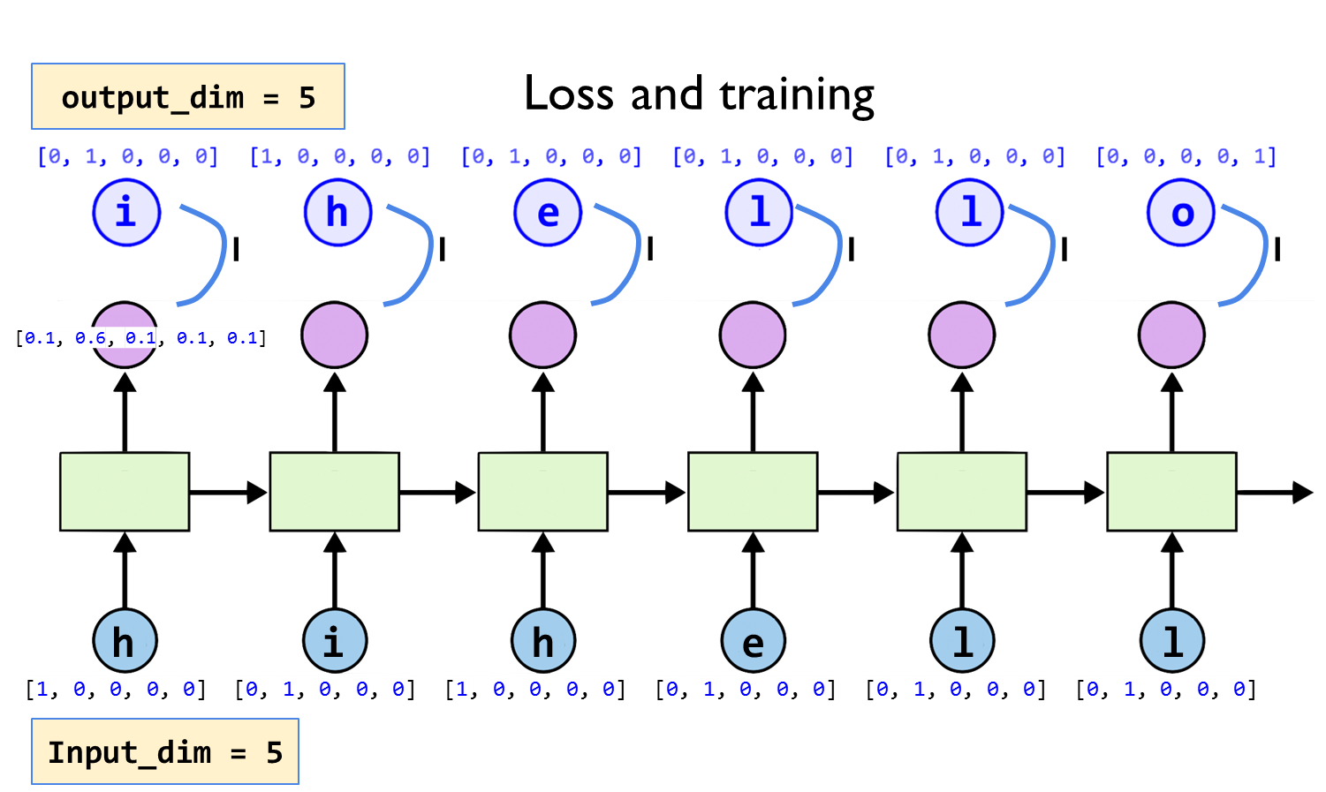

Slide 34
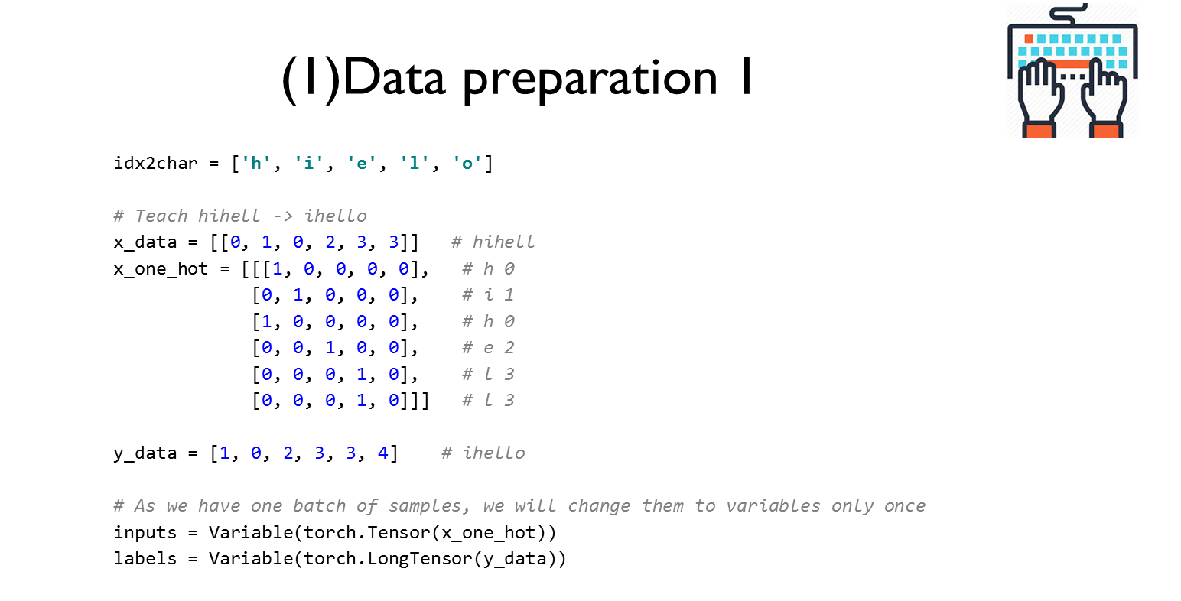

Slide 35
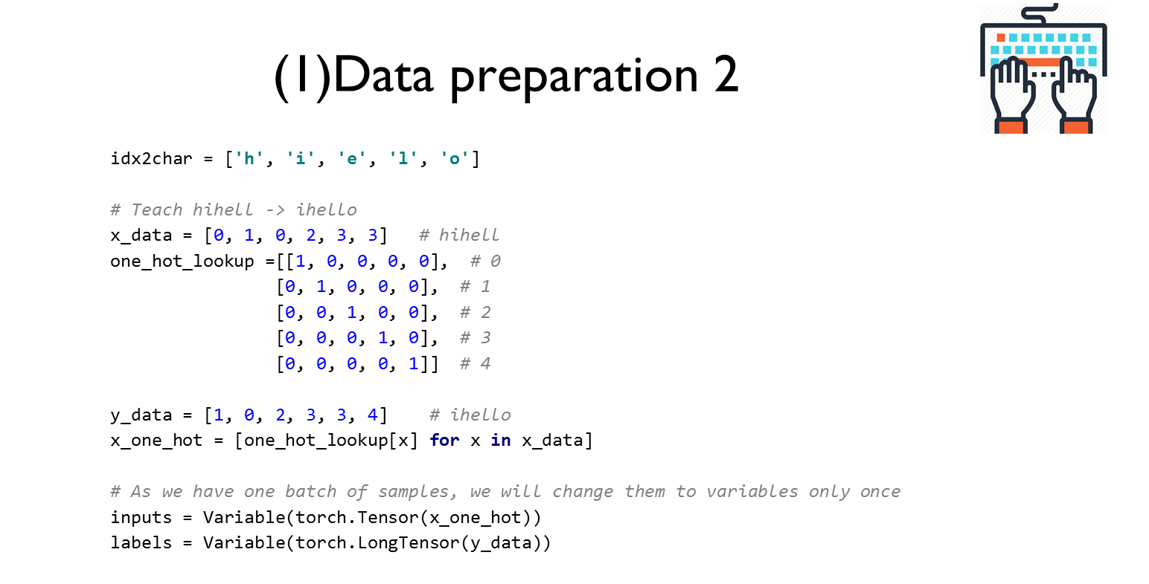

Slide 36
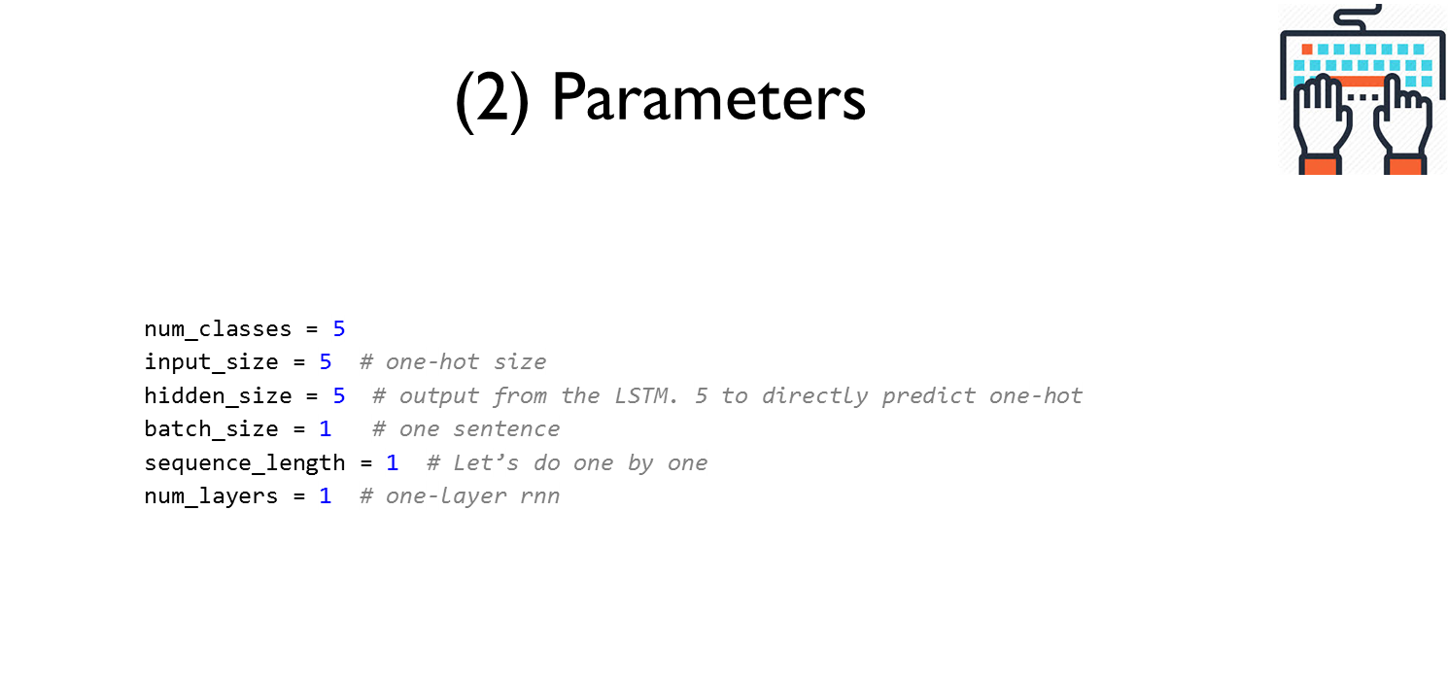

Slide 37
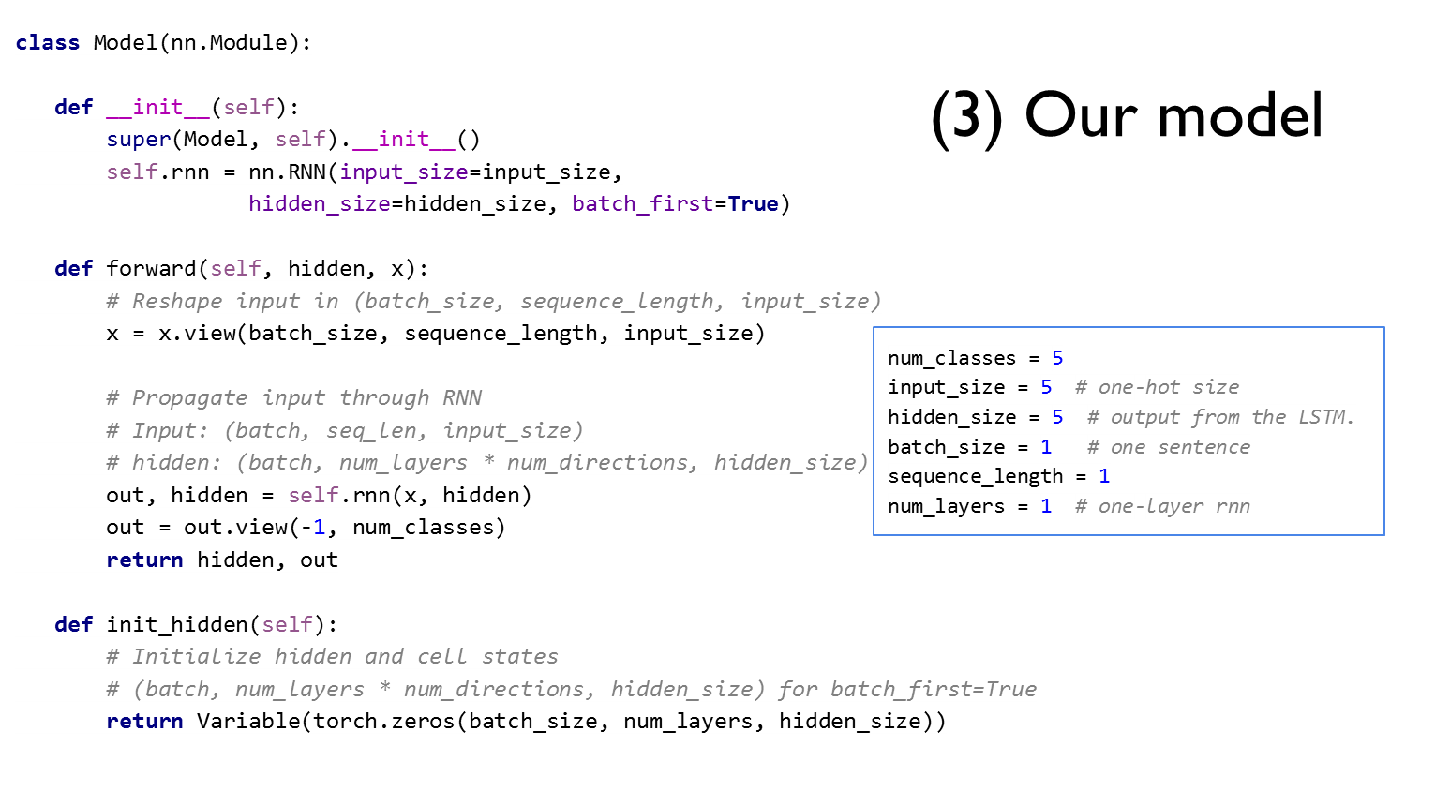

Slide 38
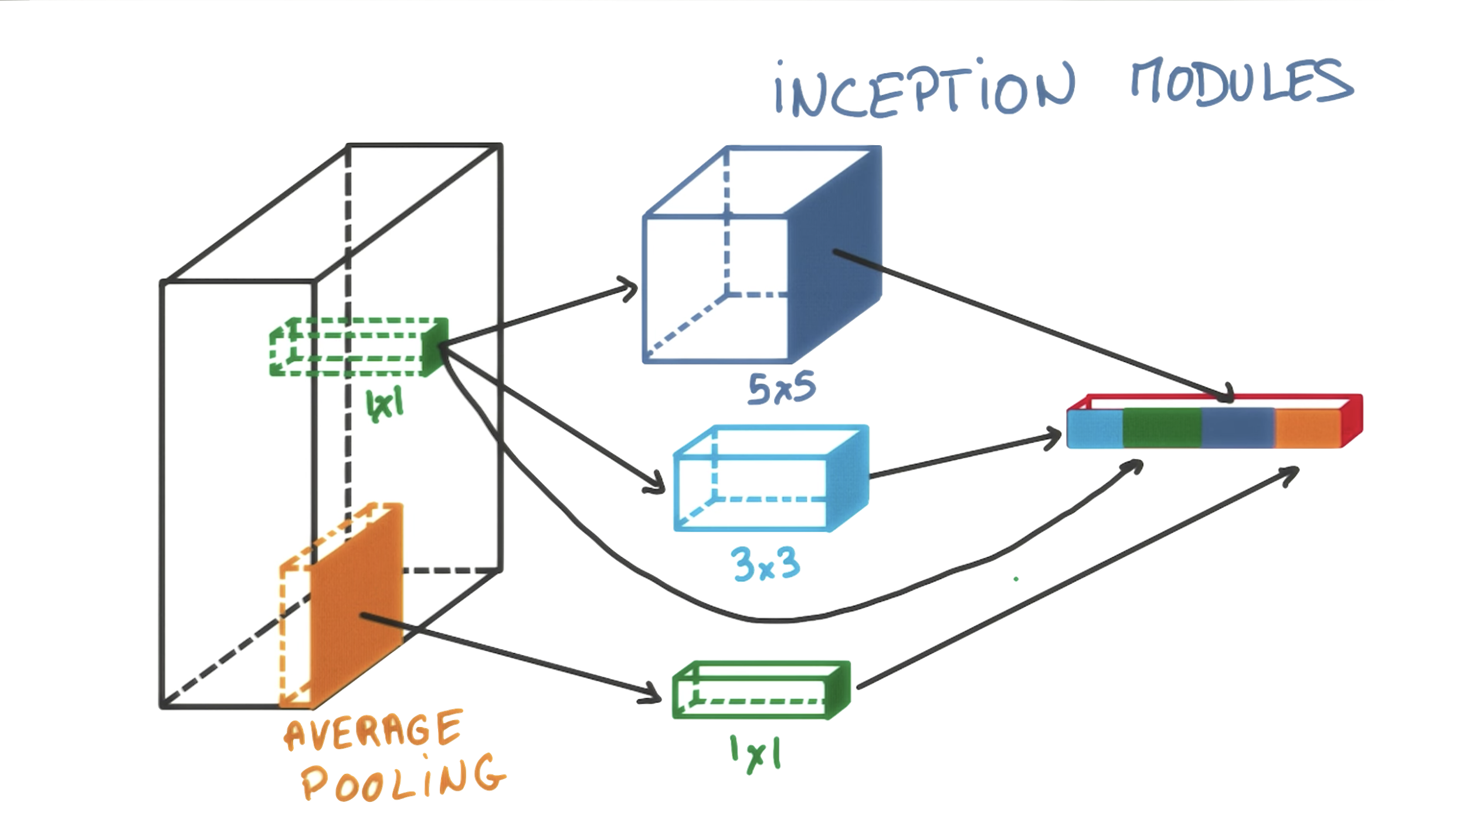
Inception Modules

Slide 39
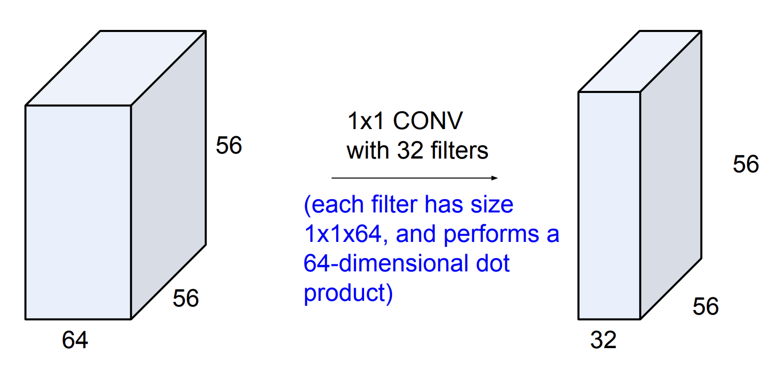
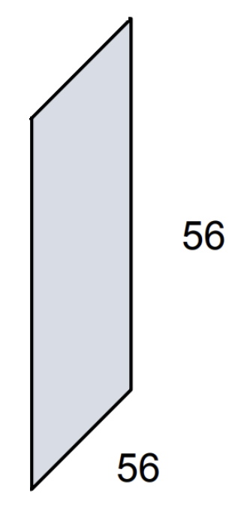

Why 1x1 convolution?

Slide 40
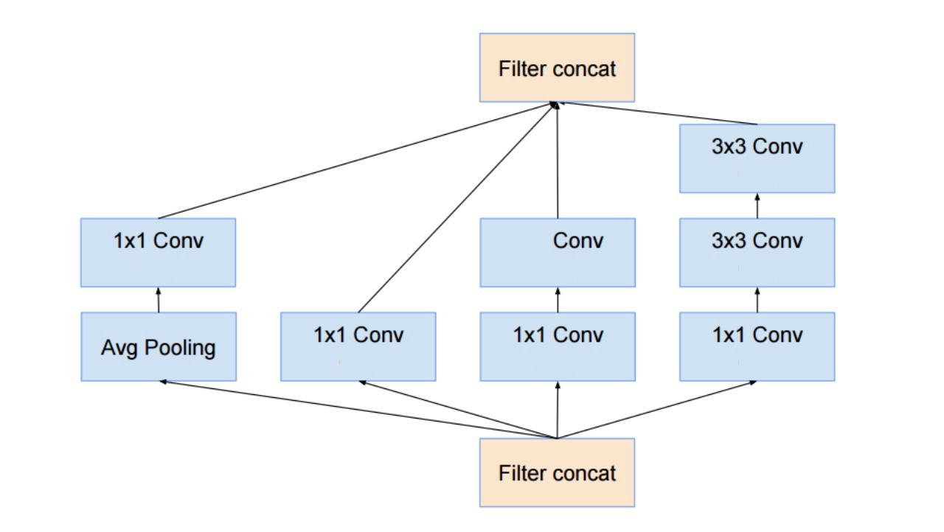
Inception Module
(24)
5x5
(24)
(24)
(24)
(16)
(16)
(16)

Slide 41
(24)
5x5
(24)
(24)
(24)
(16)
(16)
(16)

Slide 42
self.branch1x1 = nn.Conv2d(in_channels, 16, kernel_size=1)
branch1x1 = self.branch1x1(x)
(24)
5x5
(24)
(24)
(24)
(16)
(16)
(16)

Slide 43
self.branch_pool = nn.Conv2d(in_channels, 24, kernel_size=1)
branch_pool = F.avg_pool2d(x, kernel_size=3, stride=1, padding=1)
branch_pool = self.branch_pool(branch_pool)
self.branch1x1 = nn.Conv2d(in_channels, 16, kernel_size=1)
branch1x1 = self.branch1x1(x)
(24)
5x5
(24)
(24)
(24)
(16)
(16)
(16)

Slide 44
self.branch_pool = nn.Conv2d(in_channels, 24, kernel_size=1)
branch_pool = F.avg_pool2d(x, kernel_size=3, stride=1, padding=1)
branch_pool = self.branch_pool(branch_pool)
self.branch1x1 = nn.Conv2d(in_channels, 16, kernel_size=1)
branch1x1 = self.branch1x1(x)
(24)
5x5
(24)
(24)
(24)
self.branch5x5_1 = nn.Conv2d(in_channels, 16, kernel_size=1)
self.branch5x5_2 = nn.Conv2d(16, 24, kernel_size=5, padding=2)
branch5x5 = self.branch5x5_1(x)
branch5x5 = self.branch5x5_2(branch5x5)
(16)
(16)
(16)
self.branch3x3dbl_1 = nn.Conv2d(in_channels, 16, kernel_size=1)
self.branch3x3dbl_2 = nn.Conv2d(16, 24, kernel_size=3, padding=1)
self.branch3x3dbl_3 = nn.Conv2d(24, 24, kernel_size=3, padding=1)
branch3x3dbl = self.branch3x3dbl_1(x)
branch3x3dbl = self.branch3x3dbl_2(branch3x3dbl)
branch3x3dbl = self.branch3x3dbl_3(branch3x3dbl)

Slide 45
self.branch_pool = nn.Conv2d(in_channels, 24, kernel_size=1)
branch_pool = F.avg_pool2d(x, kernel_size=3, stride=1, padding=1)
branch_pool = self.branch_pool(branch_pool)
outputs =
[branch1x1,
branch5x5,
branch3x3dbl,
branch_pool]
self.branch1x1 = nn.Conv2d(in_channels, 16, kernel_size=1)
branch1x1 = self.branch1x1(x)
(24)
5x5
(24)
(24)
(24)
self.branch5x5_1 = nn.Conv2d(in_channels, 16, kernel_size=1)
self.branch5x5_2 = nn.Conv2d(16, 24, kernel_size=5, padding=2)
branch5x5 = self.branch5x5_1(x)
branch5x5 = self.branch5x5_2(branch5x5)
(16)
(16)
(16)
self.branch3x3dbl_1 = nn.Conv2d(in_channels, 16, kernel_size=1)
self.branch3x3dbl_2 = nn.Conv2d(16, 24, kernel_size=3, padding=1)
self.branch3x3dbl_3 = nn.Conv2d(24, 24, kernel_size=3, padding=1)
branch3x3dbl = self.branch3x3dbl_1(x)
branch3x3dbl = self.branch3x3dbl_2(branch3x3dbl)
branch3x3dbl = self.branch3x3dbl_3(branch3x3dbl)

Slide 46
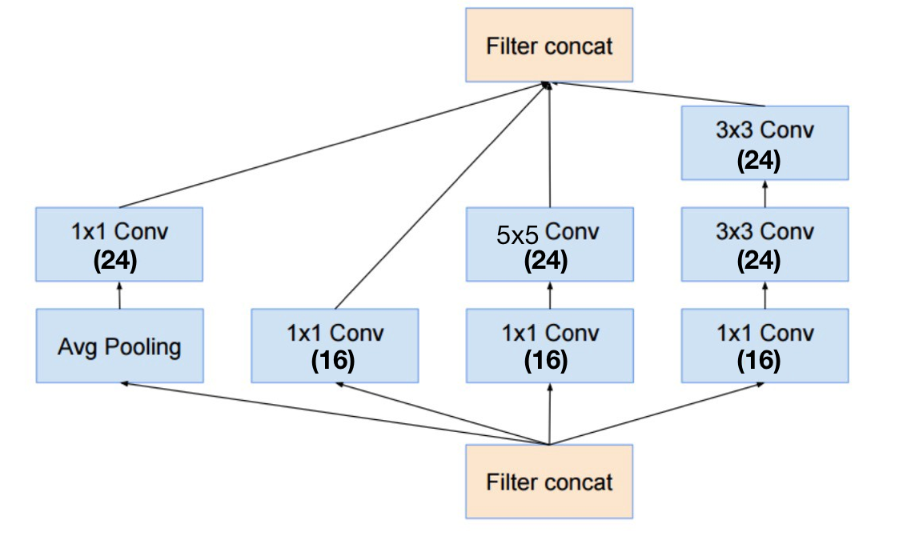
Inception Module
class InceptionA(nn.Module):
def __init__(self, in_channels):
super(InceptionA, self).__init__()
self.branch1x1 = nn.Conv2d(in_channels, 16, kernel_size=1)
self.branch5x5_1 = nn.Conv2d(in_channels, 16, kernel_size=1)
self.branch5x5_2 = nn.Conv2d(16, 24, kernel_size=5, padding=2)
self.branch3x3dbl_1 = nn.Conv2d(in_channels, 16, kernel_size=1)
self.branch3x3dbl_2 = nn.Conv2d(16, 24, kernel_size=3, padding=1)
self.branch3x3dbl_3 = nn.Conv2d(24, 24, kernel_size=3, padding=1)
self.branch_pool = nn.Conv2d(in_channels, 24, kernel_size=1)
def forward(self, x):
branch1x1 = self.branch1x1(x)
branch5x5 = self.branch5x5_1(x)
branch5x5 = self.branch5x5_2(branch5x5)
branch3x3dbl = self.branch3x3dbl_1(x)
branch3x3dbl = self.branch3x3dbl_2(branch3x3dbl)
branch3x3dbl = self.branch3x3dbl_3(branch3x3dbl)
branch_pool = F.avg_pool2d(x, kernel_size=3, stride=1, padding=1)
branch_pool = self.branch_pool(branch_pool)
outputs = [branch1x1, branch5x5, branch3x3dbl, branch_pool]
return torch.cat(outputs, 1)
class Net(nn.Module):
def __init__(self):
super(Net, self).__init__()
self.conv1 = nn.Conv2d(1, 10, kernel_size=5)
self.conv2 = nn.Conv2d(88, 20, kernel_size=5)
self.incept1 = InceptionA(in_channels=10)
self.incept2 = InceptionA(in_channels=20)
self.mp = nn.MaxPool2d(2)
self.fc = nn.Linear(1408, 10)
def forward(self, x):
in_size = x.size(0)
x = F.relu(self.mp(self.conv1(x)))
x = self.incept1(x)
x = F.relu(self.mp(self.conv2(x)))
x = self.incept2(x)
x = x.view(in_size, -1) # flatten the tensor
x = self.fc(x)
return F.log_softmax(x)

Slide 47
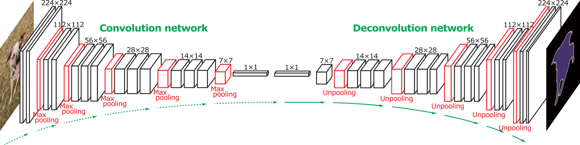
Transpose Convolution

Slide 48
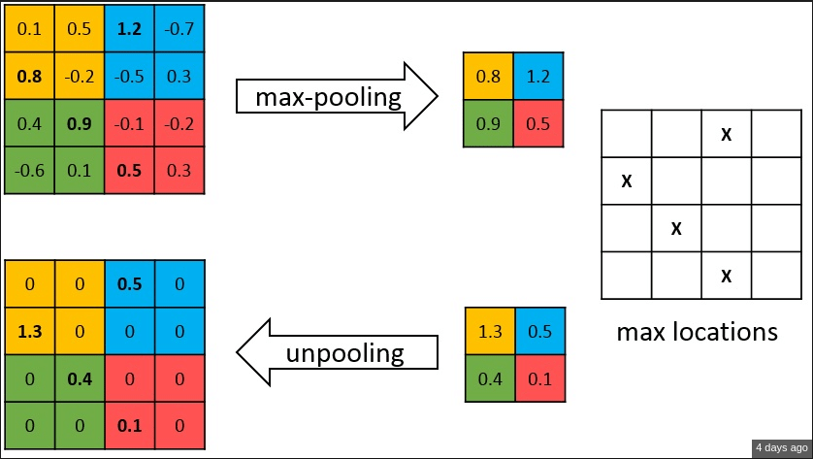
Deconvolution and Unpooling
Unpooling

